Slide 1
ESF’s Golden Jubilee
Prof. Véronique Halloin, ESF President
Strasbourg, 26 June 2024
Notes:
A 50th birthday is a significant milestone in a person's life. Reaching this age, this half-century, is often seen as an achievement and also as an opportunity for reflection and transition to a new phase in life.
The same is true for an organisation like ESF.
So I'll talk briefly about the ESF of yesterday, and, at greater length, about the current ESF and what would be or could be the esf in the future

Slide 2
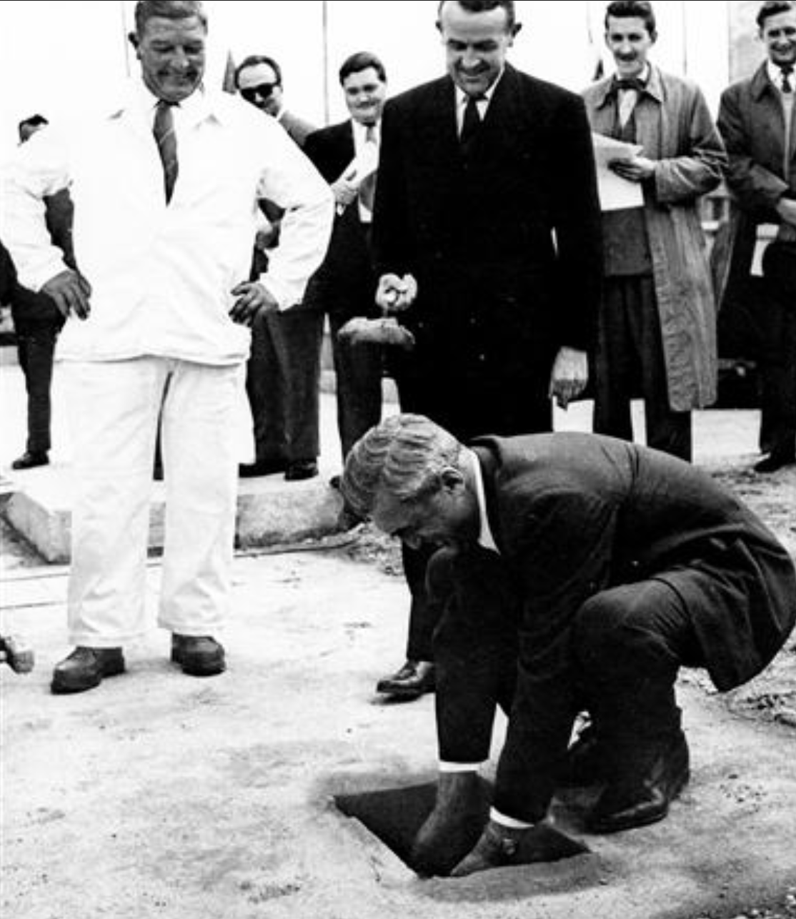

1974: multilateral scientific collaboration in its infancy (no EC framework programme, no Erasmus…)
CERN 1954
1st DG Félix Bloch laying the foundation stone on the Laboratory site
Notes:
First, let's go back 50 years ago, in 1974, multilateral scientific collaboration in Europe was at its infancy, no EC framework programme, no Marie-Sklodowska Curie Fellowships, no Erasmus… Except for CERN created in 1954, We can see here a photograph of the first DG Félix Bloch laying the foundation stone on the laboratory site,

Slide 3
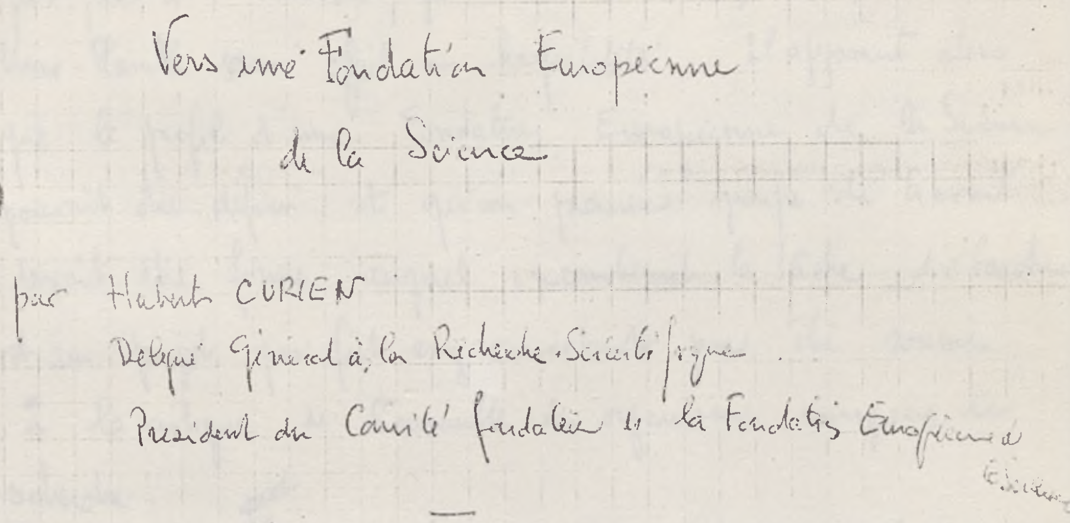
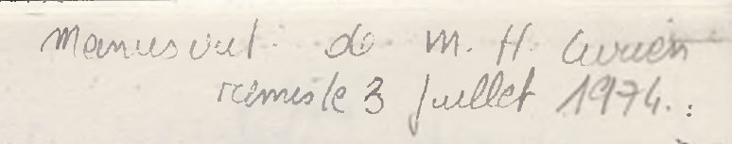
Towards a European Science Foundation (3 July 1974)
Hubert Curien DG CNRS (1963-1973) + Chairman of ESF Foundation Committee
Notes:
And it was then that the idea of a European Science foundation shape. Here is an important handwritten document by Hubert Curien, entitled Towards a European Science Foundation, and dated July 3 1974. Hubert Curien was director general of the French CNRS from 1969 to 1973, and chairman of the ESF foundation committee.

Slide 4
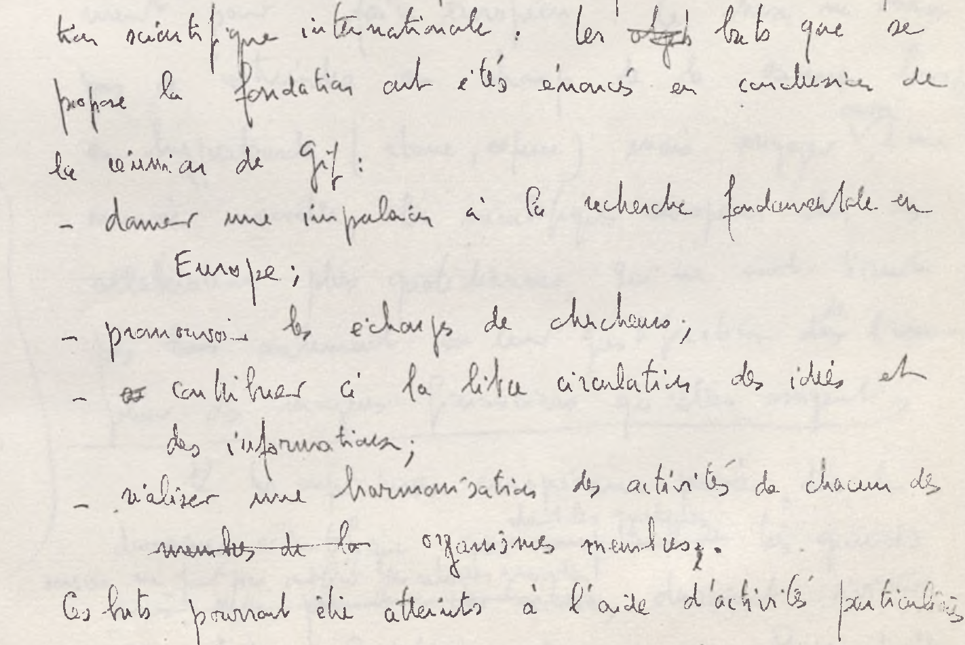
The Foundation’s Aims
Boost basic research in Europe
Promote exchanges between researchers
Free flow of ideas and information
Harmonise activities of each member organization
→ Bringing organisations together to implement concerted projects
Notes:
This historical document states that, in 1974, the foundation had the following aims:
boosting basic research in Europe
promote exchanges between researchers
contribute to the free flow of ideas and information
harmonise the activities of each member organisation
And these goals can be achieved through specific activities, such as by bringing organisations together to implement concerted projects

Slide 5
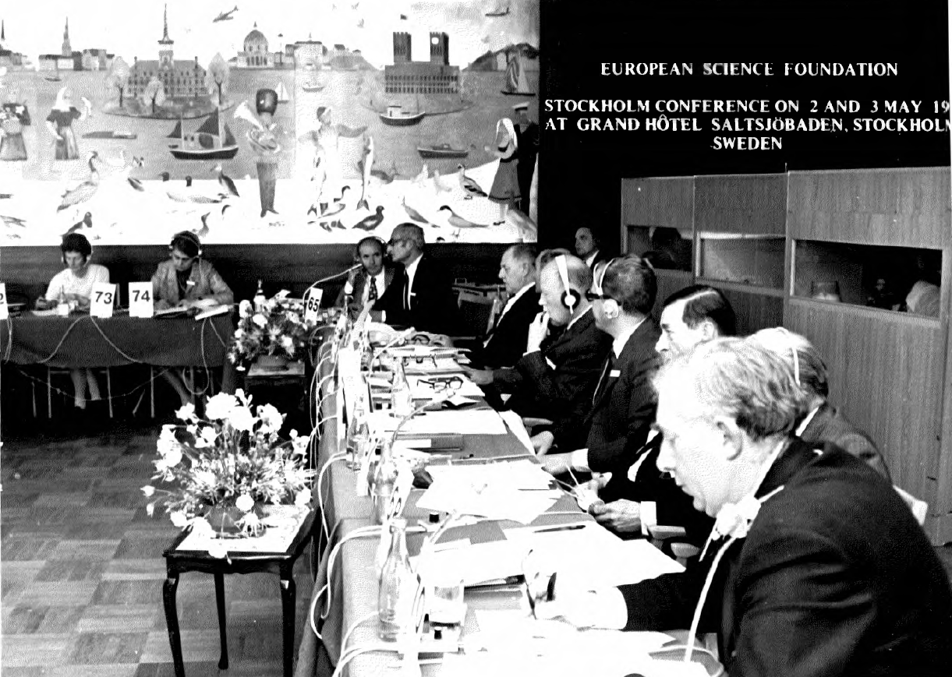

2-3 May 1974: Sweden
45 organisations - 14 countries
→ an innovative and avant-garde project)
Notes:
Indeed, the idea of creating the esf came from european research organisations. To formalise this idea, representatives of 45 research organisations from 14 european countries met near stockholm on 2 and 3 may 1974. 14 countries, 45 organizations - this may seem natural in a European Union that currently comprises 27 countries and numerous networks across the continent: but it's worth remembering that what were then known as "European communities" comprised just 9 countries at the time: this shows just how innovative and avant-garde the project was.

Slide 6
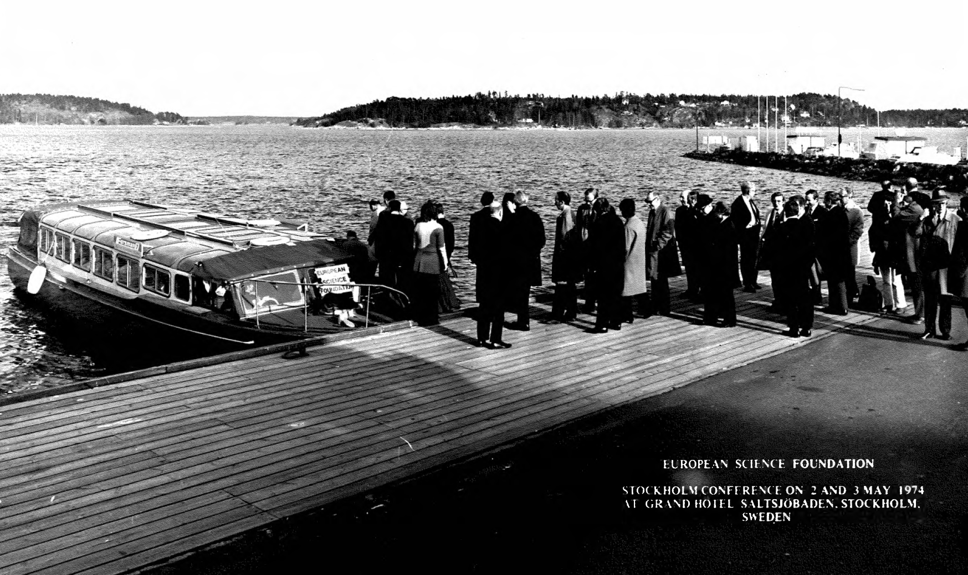
Notes:
Stockholm… Two days of intense work to draw up the foundation's articles of association, but also a few moments of relaxation on a cruise.

Slide 7
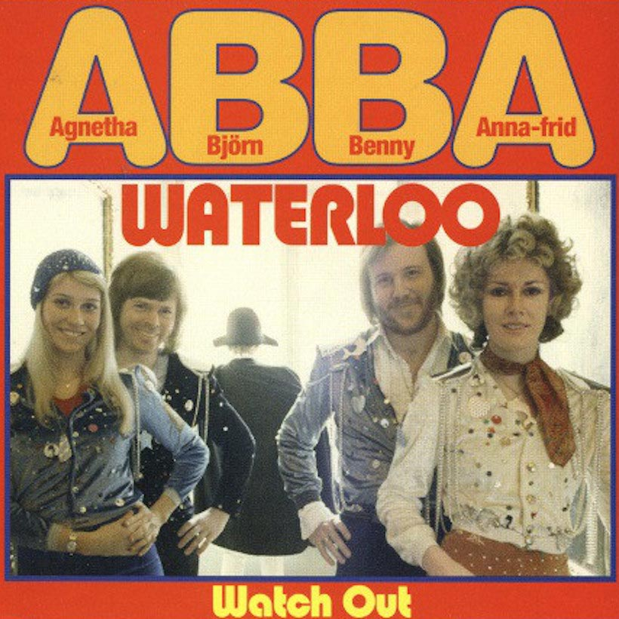
Notes:
One month after the famous swedish group abba won the eurovision song contest with their worldwide hit waterloo; by the way, I myself live in belgium, 10 km from waterloo.
And when you look at the ESF's destiny and success, you can see that they were exactly the opposite of Waterloo, although it's always a matter of perspective.... It reminds me of the comment made by a French tourist couple arriving at London's Waterloo station on the Eurostar some twenty years ago (at the time, that's where it was), when the husband said to his wife: what a funny idea to have named a station after a defeat!

Slide 8
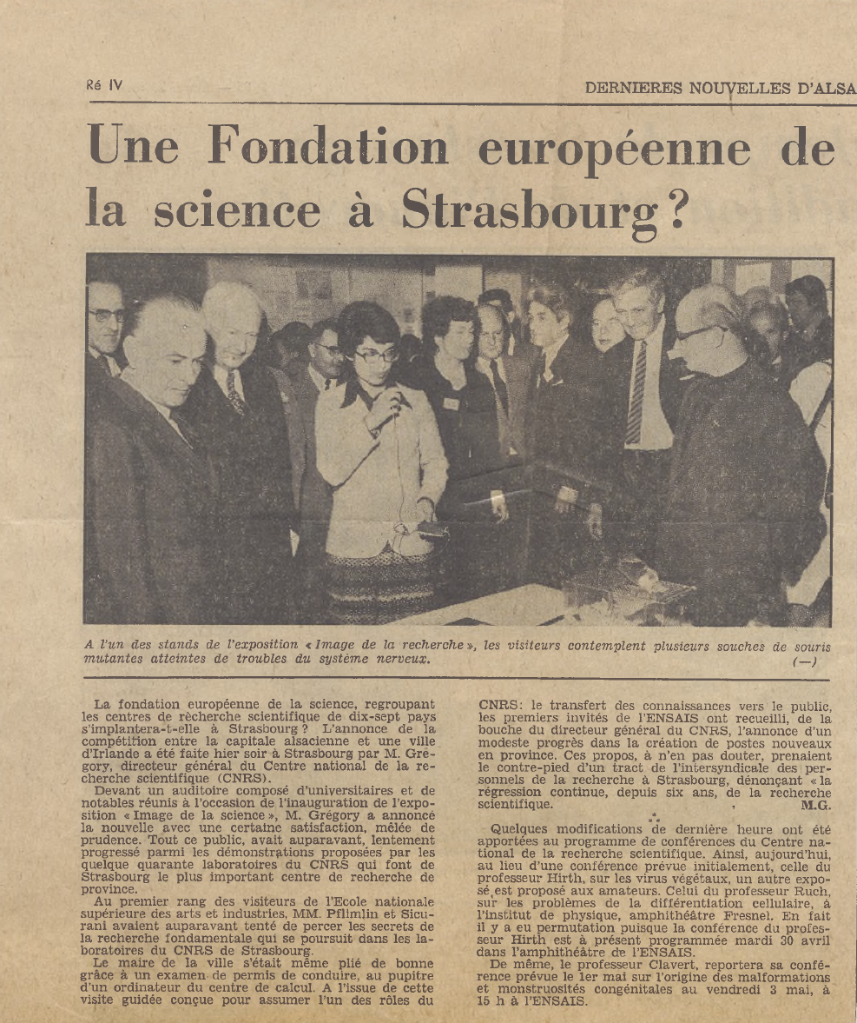
A European Science Foundation in Strasbourg?
Dernières Nouvelles d’Alsace
Notes:
There was also the question of where to locate the esf ? Strasbourg was one possibility, as the famous newspaper les dernieres nouvelles d'alsace (in France they say DNA, now) headlined in April 1974.
About this famous regional newspaper created in 1877, we had a curious family tradition at home, my late father used to close certain discussions by saying: this was the latest news from Alsace.

Slide 9
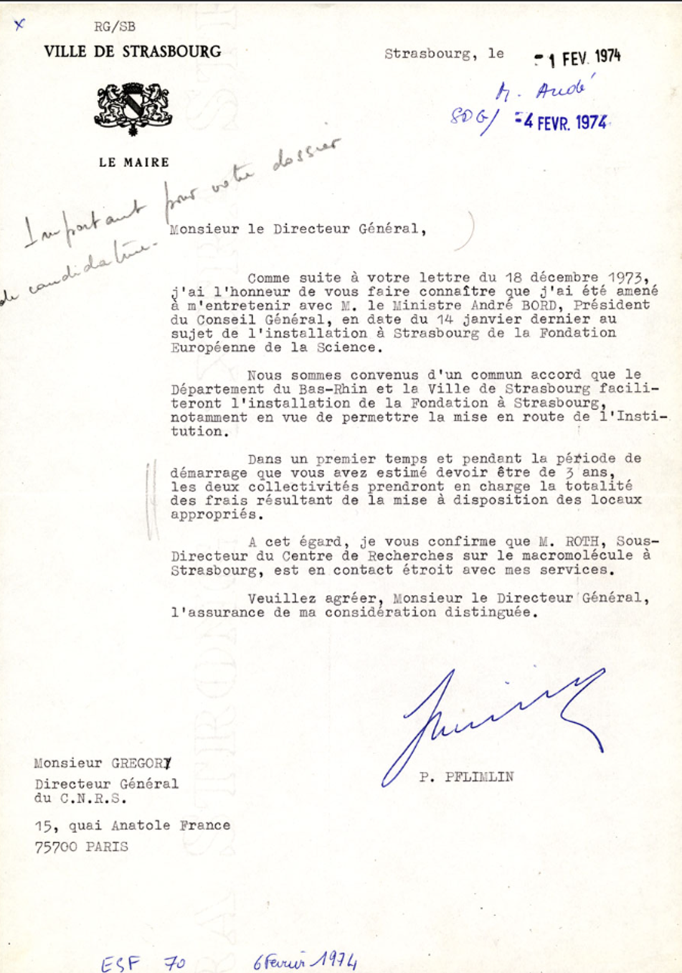
Decisive support from the City of Strasbourg
Notes:
But other locations were in competition.
Strasbourg competed with Bonn, Copenhagen, Dublin, Leiden and London and came out on top in the end, probably thanks to the support of the city that I mentioned in my welcome speech.
The local authorities have agreed to make premises available to the esf for an initial period of three years.
You can read it in this letter signed by the mayor of Strasbourg, Pierre Pfimlin and addressed to Bernard Gregory, then Director général of the CNRS. He was one of the leading scientific figures in France and Europe in the 1960s and 1970s, and in particular Director General of CERN between 1966 and 1970, as Ursula Bassler well knows.

Slide 10
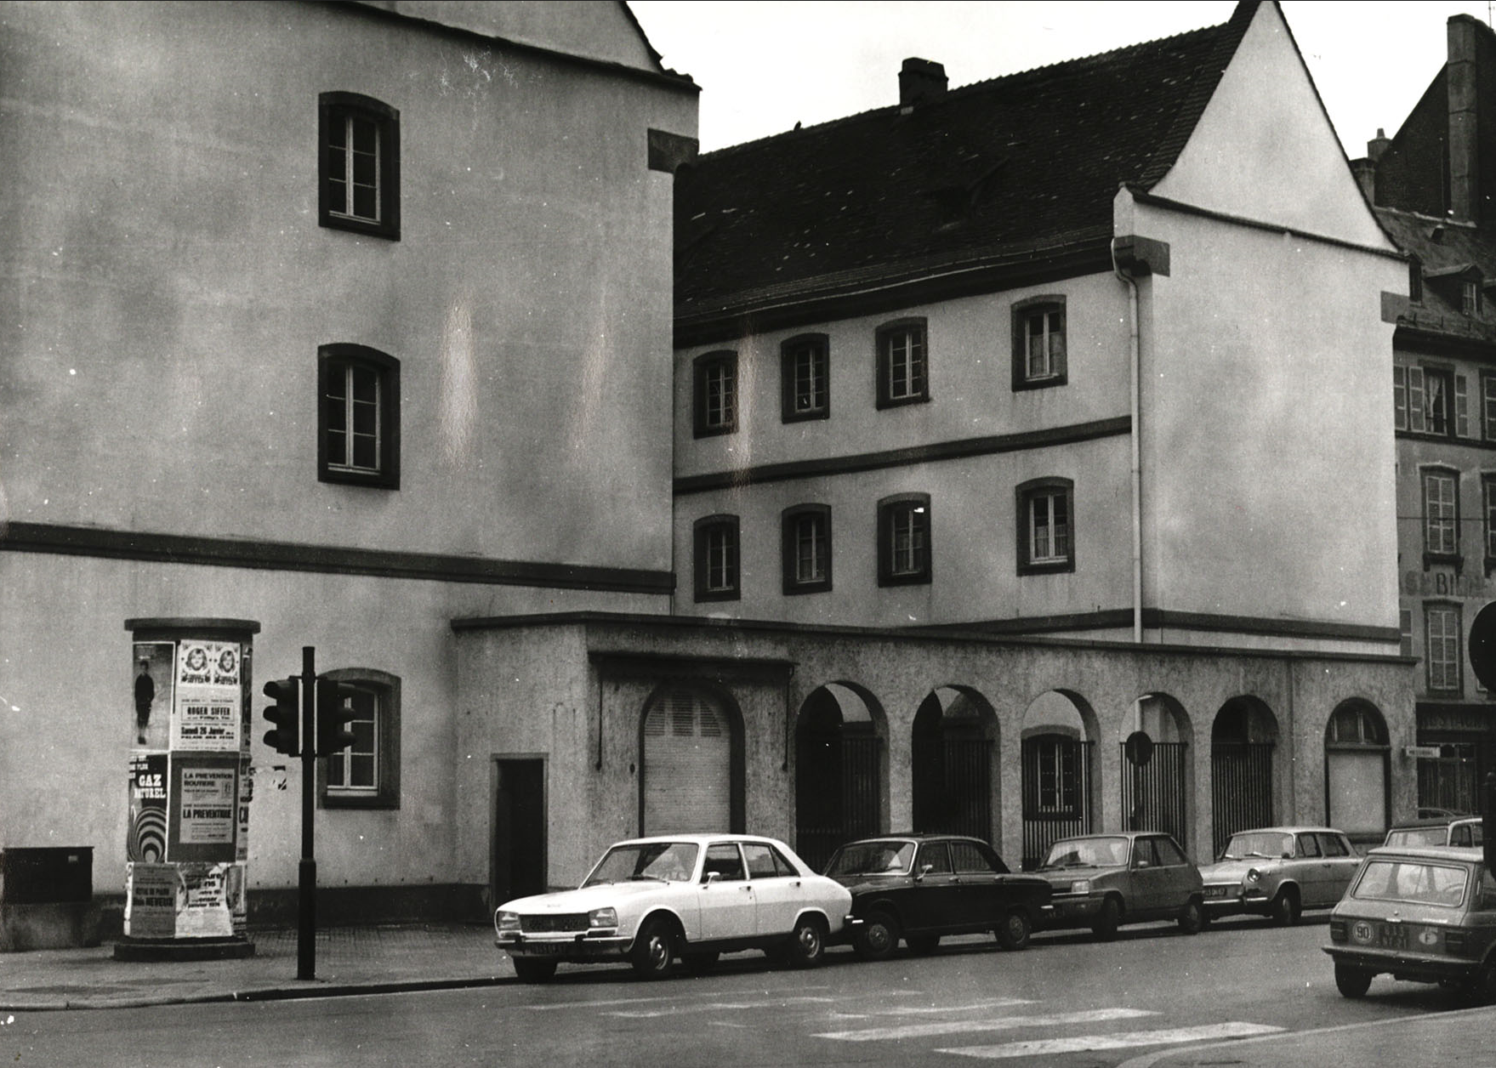
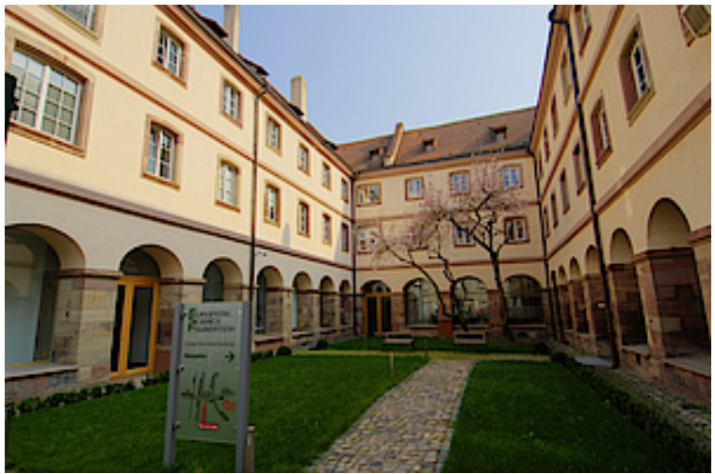
Founding Assembly in Strasbourg, November 1974
Notes:
ESF Started its activities with the founding Assembly in Strasbourg in November 1974. Here is a photograph of the building at the time.
A time when cars looked very different from today's Tesla.
The provision of these premises has been uninterrupted and is now more essential than ever for the esf's activities. We are very grateful to the local authorities.

Slide 11

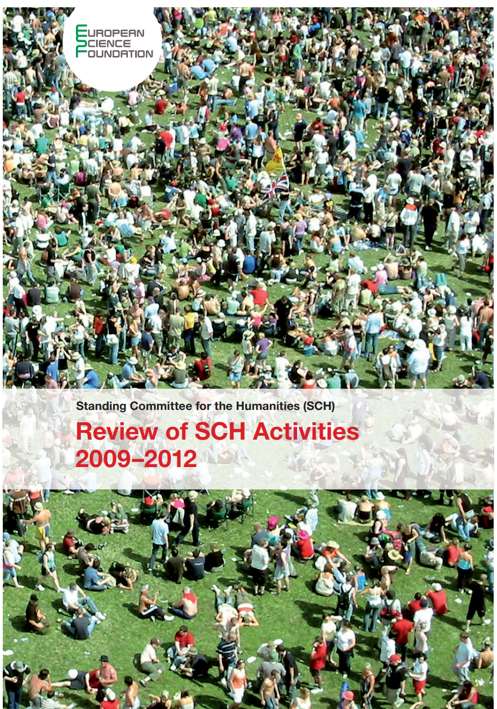
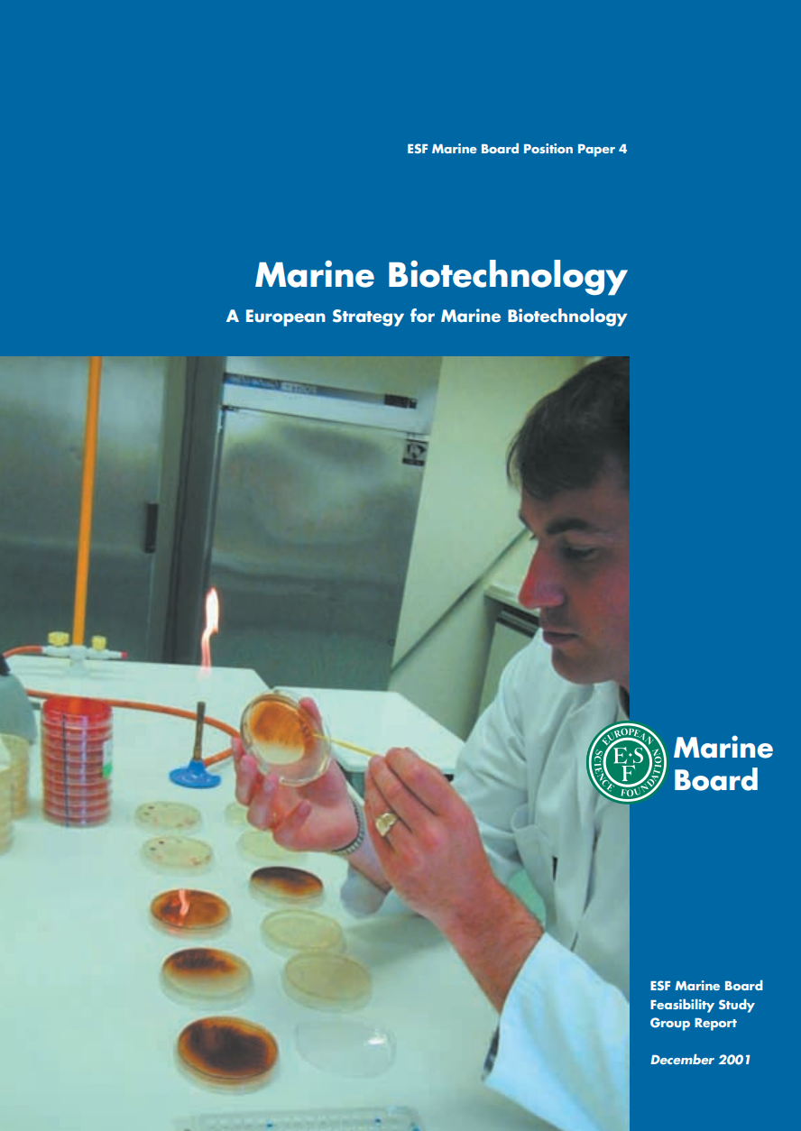
ESF’s initial activities
Networking, Funding, Coordination Activities
(Exploratory Workshops, Research Networking Programmes, Foresight prospective analyses, …)
483 Publications released over the years
Notes:
Don’t worry, I'm not a trained historian, and I'm not going to give you a year-by-year account of ESF's evolution. I'd just like to go back to 2015.
Up to 2015 indeed, ESF inception was followed by more than forty years of varied success in stimulating European research, through ESF Networking, Funding and Coordination Activities.
Including for instance Exploratory workshops, Research Networking Programmes, ESF Conferences or Foresight prospective analyses.
483 publications over this period, on a variety of timely important scientific subjects. Here are just 4 examples of these numerous publications involving in particular ESF five Scientific Standing Committees composed of leading scientists nominated by the ESF’s Member Organisations.

Slide 12






A continuous development until 2016
But a changed research landscape
ERC (research funding), Science Europe (science policy)
Notes:
ESF developed steadily till 2016. You can see here the evolution of the logos over time.
But 2015-16 definitely marked a new direction for ESF.
On the one hand, the European Research Council had been created 10 years earlier, and on the other, European research organisations have decided to prioritise science policy and created Science Europe, Science Europe advocates science and the scientific community to help build the European Research Area and shape the global scientific agenda.

Slide 13

From 2016, a relevant, valuable and sustainable new model
2015-16: drastic reduction of ESF membership and staff
2016: ESF new model
Non-for-profit organization
2 full members / 7 associated members (8 countries)
A range of useful services to the scientific community
Research assessment and grant evaluation
Hosting of scientific networks
European projects coordination and management
Research programme management
A sustainable financial model
Notes:
As a result of the creation of science europe, ESF drastically reduced its membership and staff in the year that preceded and from 2016 reinvented itself and developed a new model. It became ESF Science Connect, science connect reflecting its new activities,
Nowadays, it is still a not-for-profit organization, with 9 full and associated members from 8 different European countries.
It now provides a range of useful services to the scientific communities, such as Research assessment and grant evaluation, hosting of scientific structure and platforms, coordination and management of EU projects and management of research programme.
ESF consolidated this new model and proved its relevance and value.

Slide 14
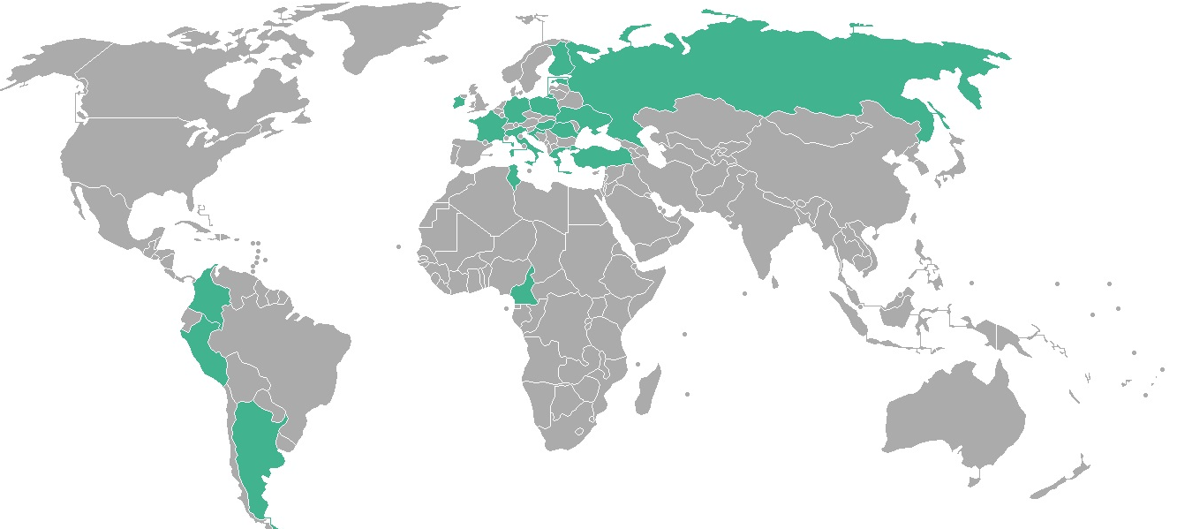
Highly qualified and dedicated staff (~50 FTE) from 18 countries
Notes:
Through this range of useful services that esf offers to the scientific community, esf has indeed succeeded in developing a sustainable financial model. Its staff and management can be very proud of it.
This achievement was only possible thanks to the highly qualified and dedicated staff, of around 50 people today, from 18 different countries coloured green on this world map.
The CEO Nicolas Walter will elaborate on the current situation. But before I give him the floor, I'd also like to talk about the future.

Slide 15
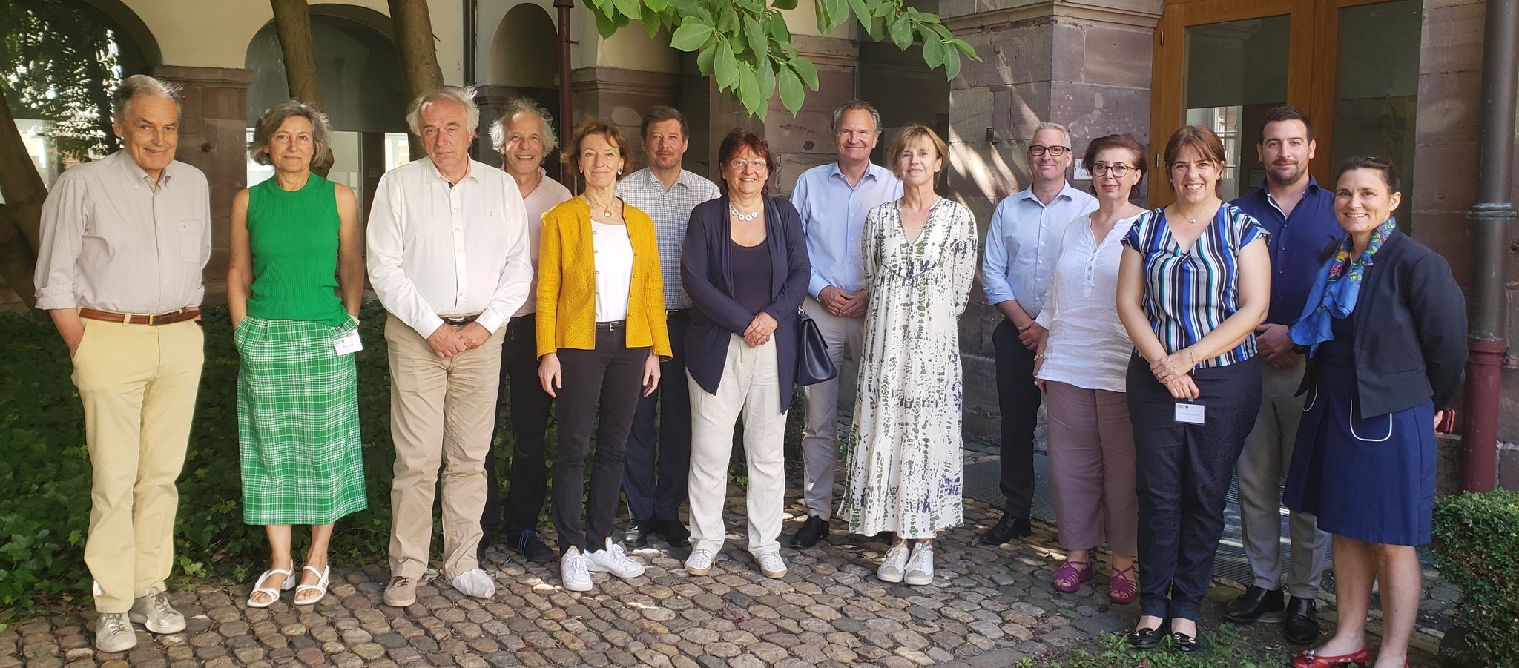
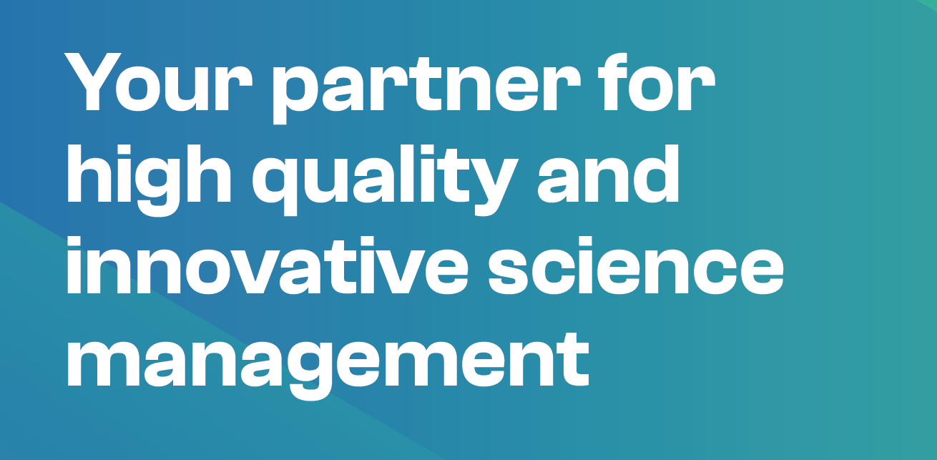
ESF Strategy 2023 - 2028
A set of guiding principles
Lines of action: to Connect and to Implement
Notes:
Today, as we look back on our journey, we indeed also look forward to the future with great optimism and determination.
There is no question of a mid-life crisis for the organisation - on the contrary.
At the beginning of July 2022, 48 years to the day after the creation of the esf, we held a high-level strategy workshop with key players in the European research landscape, to help define the strategy for the next 5 years. Some of the workshop participants are present today, I would like to thank them for their valuable inputs.
This was an opportunity to clarify our vision and guiding principles.
And our pillars, our lines of action: to connect and to implement
esf is not positioned as a lobbying or scientific policy body, but as a partner for high quality and innovative science management.

Slide 16






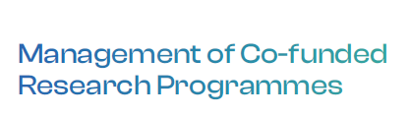


ESF’s Lines of Action
Notes:
This workshop was an opportunity to confirm the added value of esf activities for stakeholders of the european research area. In concrete terms, esf will continue and expand its current 4 lines of action, which we have been able to confirm correspond to a real need:
Research quality assessment and grant evaluation
Supporting and hosting of scientific structures and networks
Management of co-funded research programmes
And Strengthening European projects
The baseline of our new logo, that I am happy to formally inaugurate with you today, makes it clear: esf, your partner in science

Slide 17



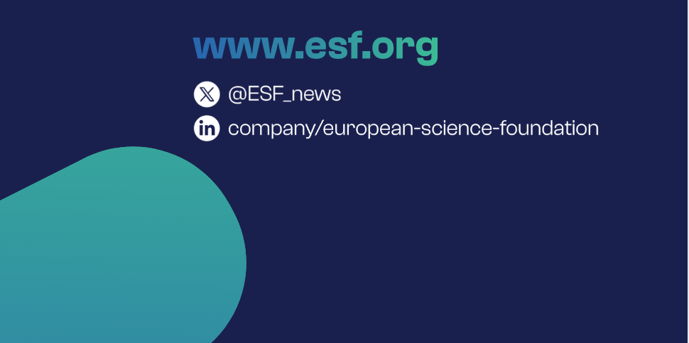
Thank you!
Notes:
I would like to thank our members for their confidence and support, our board members for their valuable contributions, and the staff and management for the quality of their work. And the audience for your attention.

